Slide 1

Presenting STANCE Presentation by Jason E. Hill
Presenting STANCE
Presentation by
Dr. Jason E. Hill
Co-investigators
Dr. Sunanda Mitra
Dr. Brian Nutter
Xiangyu Liu
Oliver Xie

Slide 2
Presenting STANCE Presentation by Jason E. Hill
Here we present the fMRI simulator STANCE, the Spontaneous and Task-related Activation of Neuronally Correlated Events simulator.
We aim to develop this into a fully functioning MATLAB toolbox with command-line functions, that can be used to generate realistic synthetic fMRI data with MATLAB scripts.
Currently, STANCE can generate data-driven synthetic neuronal activation “ground-truth”, to which motion, physiological and system noise can be added.
Ultimately STANCE will also handle correlated time-series of activations and group studies. Applications: educational and statistical/analysis benchmarking.

Slide 3
Presenting STANCE Presentation Outline
Motivation
Implementation 3D
Implementation 4D
Example results
Conclusion

Slide 4
Presenting STANCE Motivation: some BAD news…
The recent PNAS article, called “Cluster failure” from Anders Eklund, et al. calls into question fMRI activation mapping studies. They state that depending on the software package and settings, “that up to 70% of analyses produce at least one false positive.”
Neuroskeptic: “If there are lots of true positives, only a minority of positives will be false. It’s impossible to directly know the true positive rate, however.”
The STANCE simulator would allow researchers in neuroscience to have access to a synthetic ground-truth to benchmark analyses. This is a pressing need.

Slide 5




Presenting STANCE Motivation: some GOOD news…
Dynamic analysis of resting state functional MRI data is a burgeoning field, but critical issues about the analysis methods and the interpretation of the results remain unclear. Sliding window correlation is widely used, but recent studies show that it does not provide an accurate estimate of the actual changes in correlation over the course of a scan. Nevertheless, differences in patient population and individual performance levels have been successfully detected using sliding windows, suggesting that the method retains sensitivity to relevant structure within the data. This symposium will bring together different perspectives on when sliding window approaches work and when they fail, discuss other techniques that may prove more sensitive to network dynamics, and begin to examine how the brain states identified with dynamic connectivity analysis relate to underlying changes in cognitive state.
http://www.restingstate.com/2016/dynamic-functional-connectivity/

Slide 6
Presenting STANCE Motivation: Our goal
The complex nature of fMRI data generation and acquisition challenges the true estimation and interpretation of task-related activation maps or resting state functional connectivity networks, despite the use of various statistical data analysis methodologies.
The goal of developing the STANCE simulator is to generate “real-enough” resting-state and/or task-related 4D BOLD signals given certain experimental paradigms by using digital phantoms. System and physiological noise as well as motion are to be generated to serve as a reference for fMRI confounds.

Slide 7
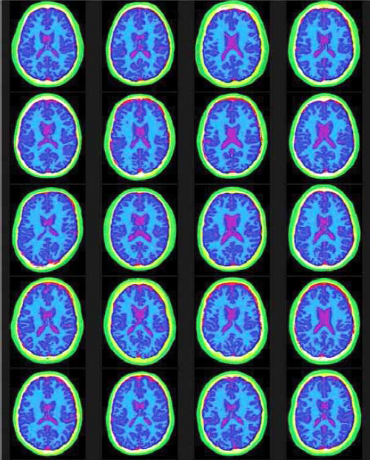
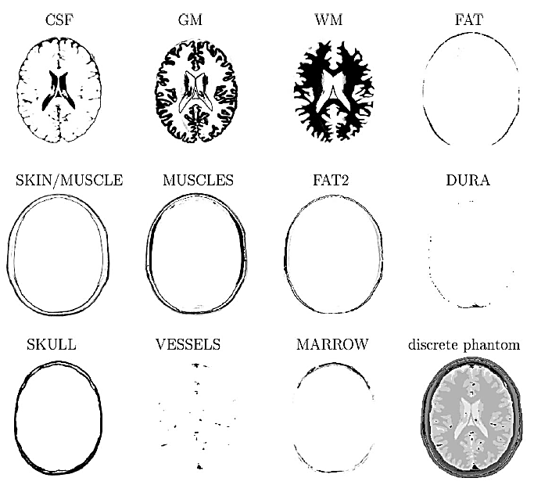
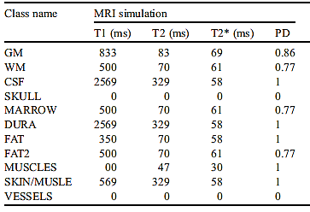
Presenting STANCE Implementation 3D: Select subject
Select a subject – the one of the 20 available brains (10 male, 10 female) as provided by BrainWEB’s 20 normal anatomical brain phantoms.
Each brain phantom has an anatomical T1-weighted volume and fuzzy membership volumes for 12 different tissues types.
Aubert-Broche, B., Griffin, M., Pike, G.B., Evans, A.C. & Collins, D.L. (Nov. 2006) “Twenty New Digital Brain Phantoms for Creation of Validation Image Data Bases,” IEEE Transactions on Medical Imaging 25(11) pp. 1410–1416.

Slide 8
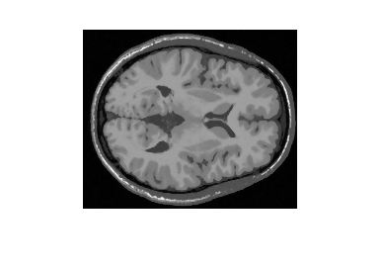
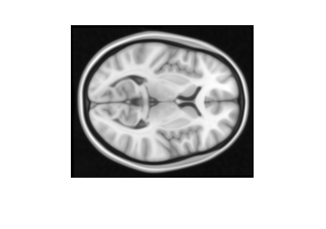
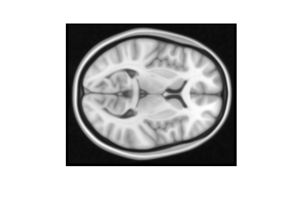
Presenting STANCE Implementation 3D: Register MNI152 to native
Register MNI152 brain to native space
Subject’s native space has a voxel size of 1mm³ with dimensions 181x217x181
T1-w data &12 fuzzy tissue membership volumes from one of 20 brain phantoms; average PD, T₁ & T₂* values for various tissues
Register
Affine transform of MNI152 to subject’s native space
MNI152 brain

Slide 9
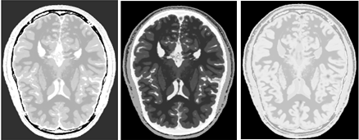
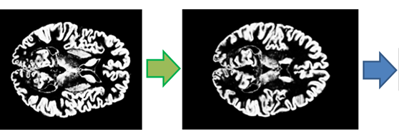

Presenting STANCE Implementation 3D: Create baseline volumes
Construct PD, T₁ & T₂* volumes
Generate functional space (fMRI scan)
Gray matter priors in functional space
Rotated by tilt angle.
Resize voxels and reslice volume with slice gap
and new dimensions.

Slide 10
Presenting STANCE Implementation 3D: simulate first fMRI study
In this example, a model of photic stimulated activation of the visual cortex is defined by two ellipsoids with centers [7, -68, 8] and [-8, -65, 8] (MNI coordinates, as reported in the literature); both with the estimated volume 5,000 mm³ and aspect ratio 4:3:4, and and rotations about the X-axis of -30º and +30º respectively and 0.005 exponential falloff with a floor (min amplitude) of 0.2 of maximum. This is a model of the activation observed in the very first fMRI experiment published in 1991.

Slide 11
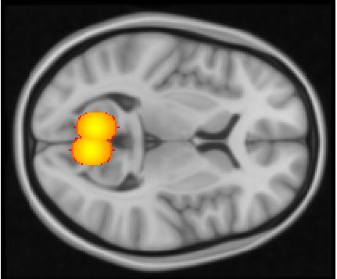
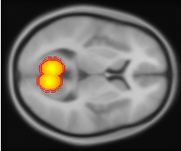

Presenting STANCE Implementation 3D: model the activation map
Define activation regions from data/ shapes; Gaussian mask in MNI space
Transform & reslice activations to functional space; mask with gray matter

Slide 12
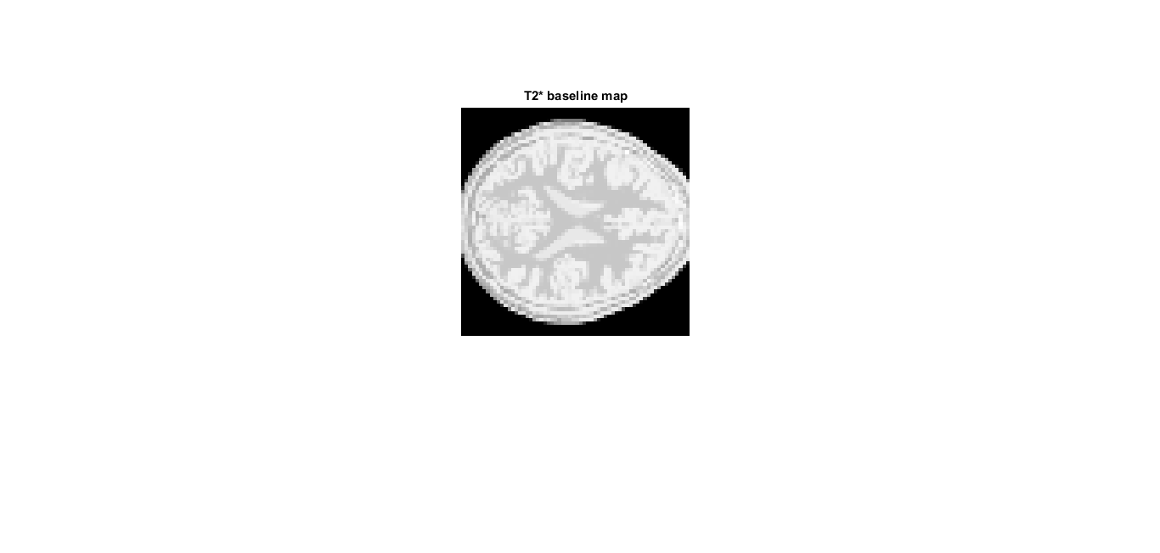
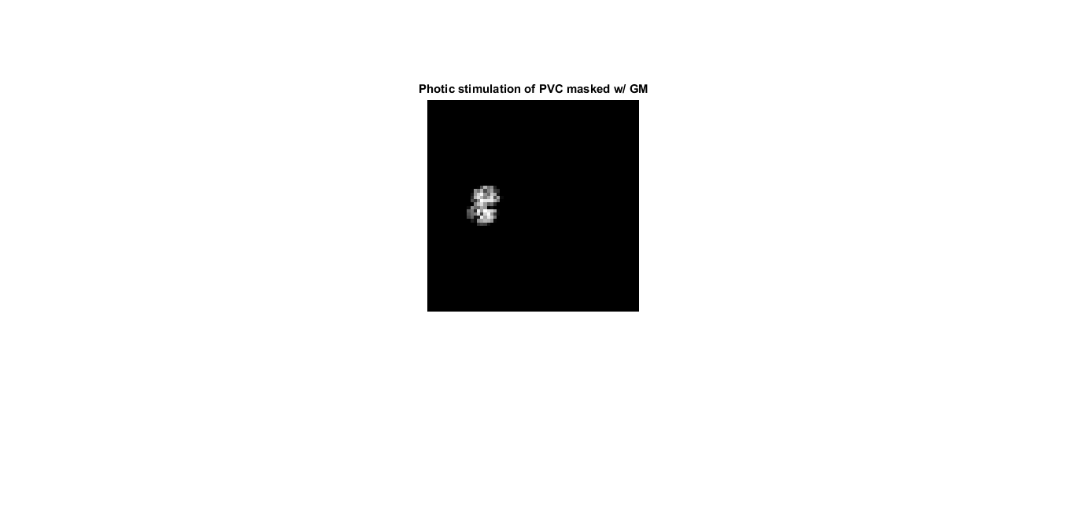

Presenting STANCE Implementation 3D: model the BOLD response
Construct T₂* volume with activation

Slide 13

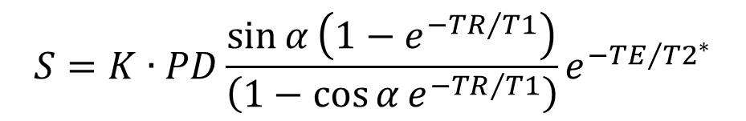
Presenting STANCE Implementation 3D: calculate the MRI signal
Solve EPI signal equation
$$S=K∙PD\frac{\sin{α}\left(1−e^{−{TR}/{T1}}\right)}{\left(1−\cos{α}e^{−{TR}/{T1}}\right)}e^{−{TE}/{{T2}^{∗}}}$$
Left: Pristine EPI signal; Right: difference between EPI signal and that with no activation.

Slide 14
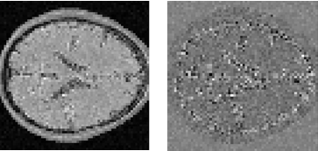

Presenting STANCE Implementation 3D: noisy data
Add noise, attenuation, motion, etc.
OUTPUT:
*.nii.gz
Compressed
NIFTI file
Left: with 4% of peak system noise; Middle: difference between noisy and pristine signals; Right: an attenuated signal (λ = 8.33 mm).

Slide 15
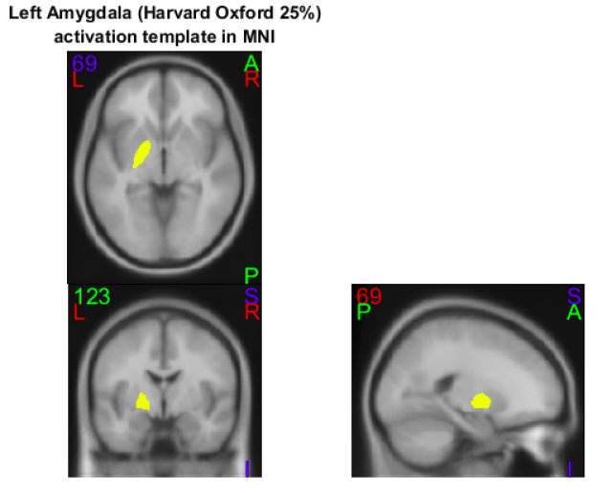
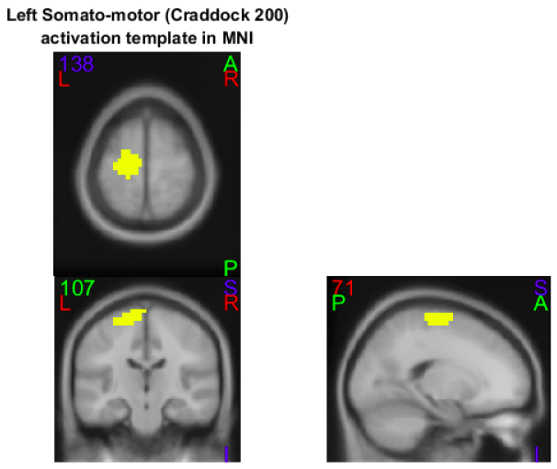
Presenting STANCE Implementation 3D: define map from atlas
Activation maps may also be defined from atlases, such as AAL, Brodmann, Harvard-Oxford, Craddock and Brainnetome.

Slide 16
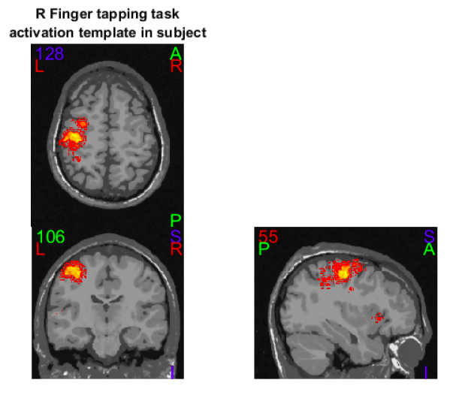
Presenting STANCE Implementation 3D: define map from data
Data derived maps from www.neurosynth.org.

Slide 17
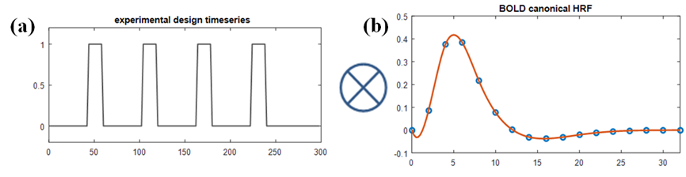
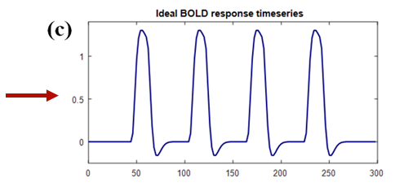
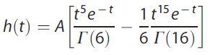
Presenting STANCE Implementation 4D: experimental design & HRF
To generate 4D time-series the experimental design must be specified along with the hemodynamic response function (HRF) and model.
This is the sustained model of the hemodynamic response: the HRF convolved with the boxcar.

Slide 18
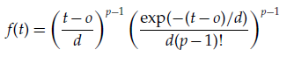
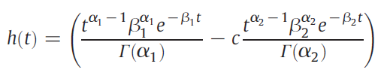
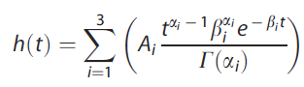
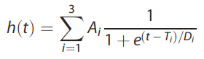
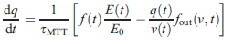
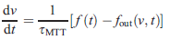
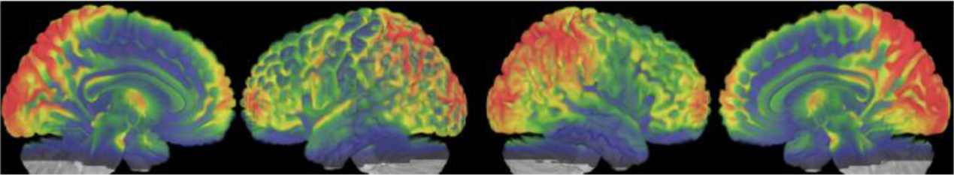
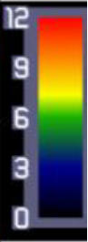
Presenting STANCE Implementation 4D: HRF modeling & variability
There are various ways to model the HRF and the parameters can vary across subjects and their brains.
Gamma distribution:
Double Gamma:
Triple Gamma:
Triple Logit:
Balloon Model: ;
HRF height across brain. Source: Wu, G-R., and Marinazzo, D., "HRF in resting brain" bioRχiv (beta)

Slide 19
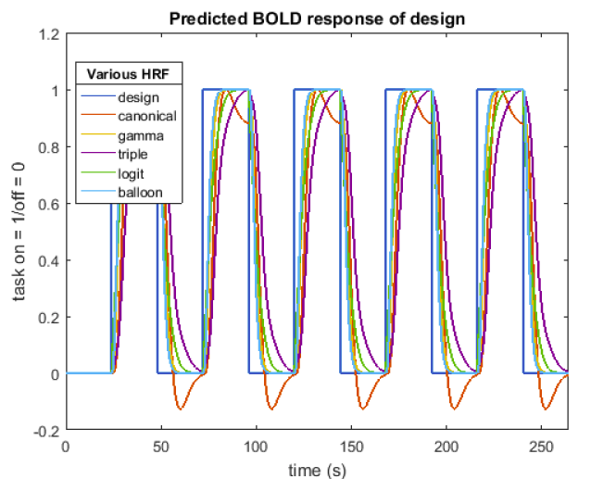
Presenting STANCE Implementation 4D: HRF modeling continued

Slide 20
Presenting STANCE Implementation 4D: OSO model of response
This is the transient model of the hemodynamic response: the HRF convolved with the derivative of boxcar (specifically at the onset and offset times). Onset to Offset response ratio set to 0.5.

Slide 21
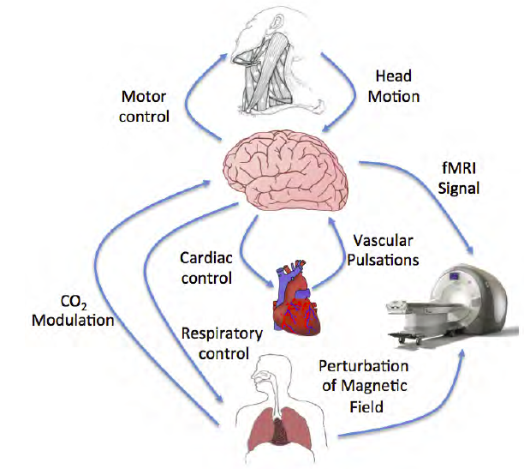
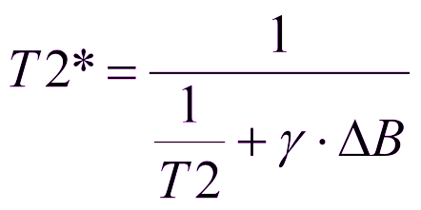
Presenting STANCE Implementation 4D: noise in fMRI signals
Temperature
and
system
Source: Thomas T. Liu, “Noise contributions to the fMRI signal: An Overview” NeuroImage (2016).

Slide 22
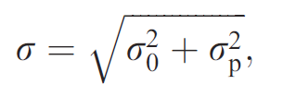
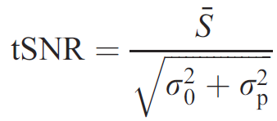
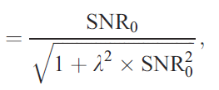
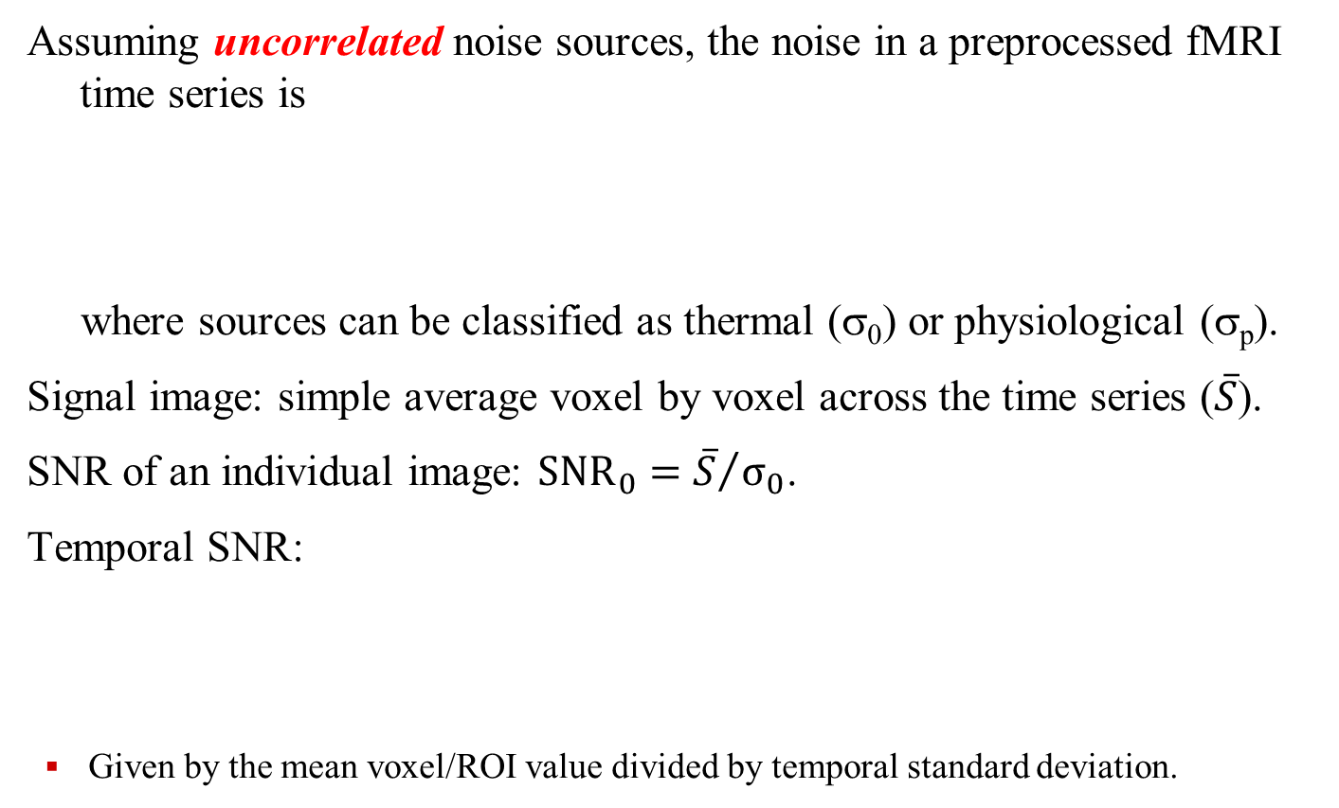
Presenting STANCE Implementation 4D: tSNR noise model
Assuming uncorrelated noise sources, the noise in a preprocessed fMRI time series is
where sources can be classified as thermal (σ₀) or physiological (σ_{p}).
Signal image: simple average voxel by voxel across the time series ($\overline{S}$).
SNR of an individual image: ${SNR}_{0}={\overline{S}}/{σ_{0}}$.
Temporal SNR:
Given by the mean voxel/ROI value divided by temporal standard deviation.
Sources: Triantafyllou et al., 2005; Friedmann & Glover 2006.

Slide 23
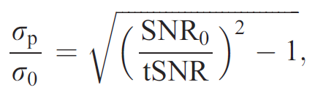
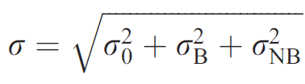
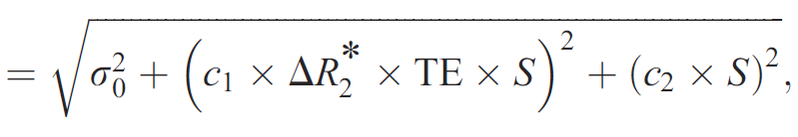
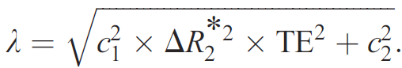
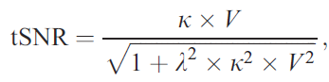
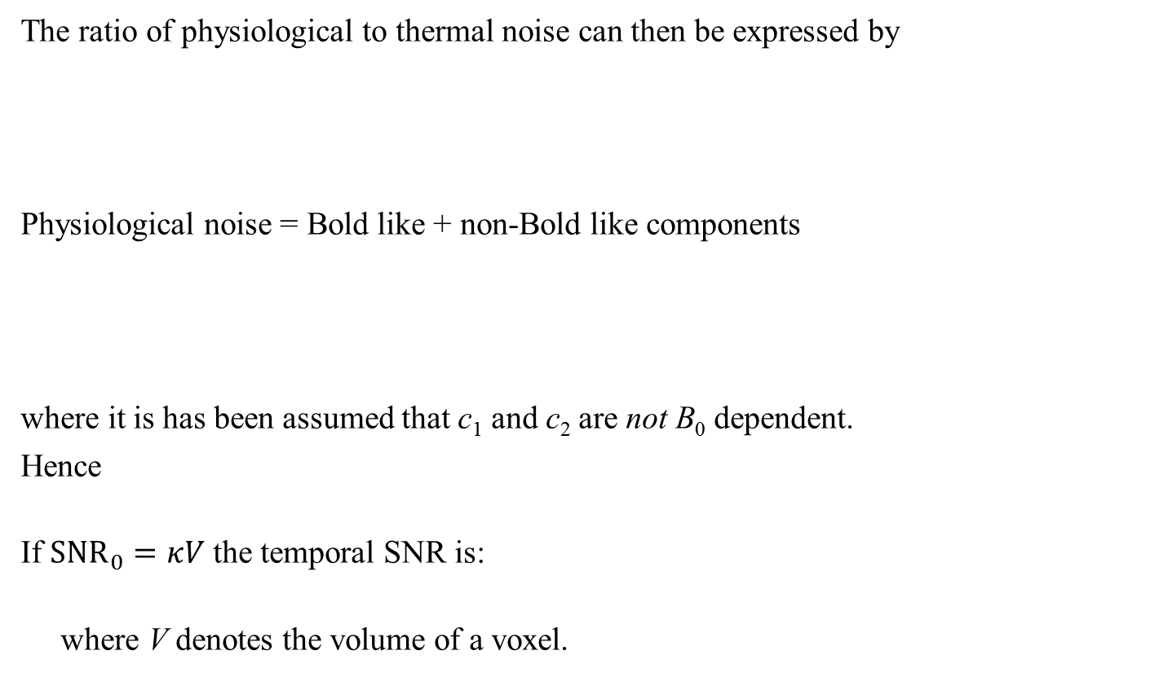
Presenting STANCE Implementation 4D: tSNR noise model (cont.)
The ratio of physiological to thermal noise can then be expressed by
Physiological noise = Bold like + non-Bold like components
where it is has been assumed that c₁ and c₂ are not B₀ dependent.
Hence
If ${SNR}_{0}=κV$ the temporal SNR is:
where V denotes the volume of a voxel.
Sources: Krueger and Glover, 2001; Triantafyllou et al., 2005.

Slide 24
Presenting STANCE Implementation 4D: noise sources
The vertical displacement of the chest during regular respiration is then modeled for the i^{th} cycle as
The system noise has a Rician distribution. Physiological noise in MRI signals comes from 6 sources:
The respiratory pulse (RP) follows the respiratory volume time-series (RVT) or the chest displacement time-series;
The cardiac pulse (CP) follows the pulse wave velocity (PWV);
The interaction between CP and RP (InterCRP);
The result of the respiratory response function (RRF) convolved with the RVT;
The result of the cardiac response function (CRF) convolved with heart rate variability (HRV);
Mayer waves due to variation in arterial blood pressure (BP).

Slide 25
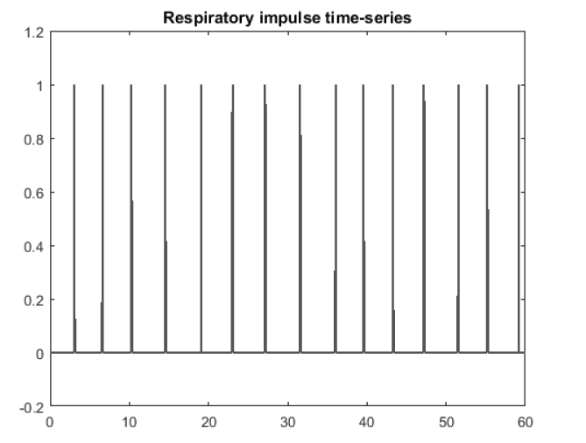
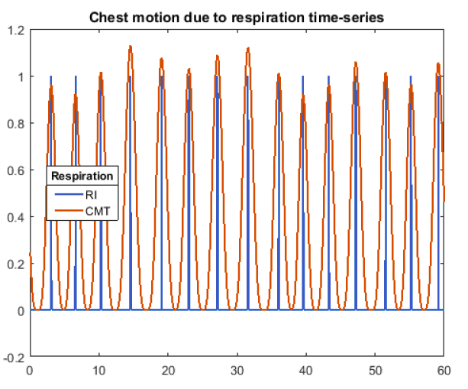
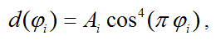
Presenting STANCE Implementation 4D: respiratory motion
The vertical displacement of the chest during regular respiration is then modeled for the i^{th} cycle as
The modeling of physiological noise begins with modeling the chest displacement motion due to respiration.
The vertical displacement of the chest during regular respiration is modeled for the i^{th} cycle as where φ ∈ [-0.5,+0.5] parametrizes the time/RI, relative to
the i^{th} impulse; the amplitude A_{i} is proportional to the RI with average of 1.0 cm.

Slide 26
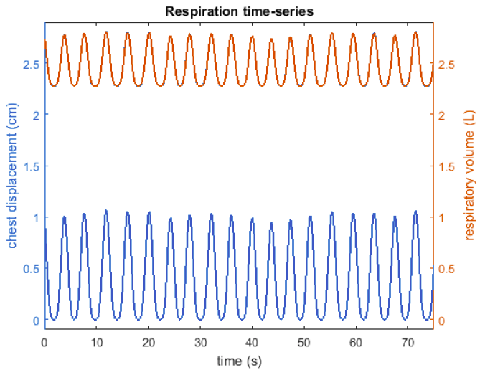
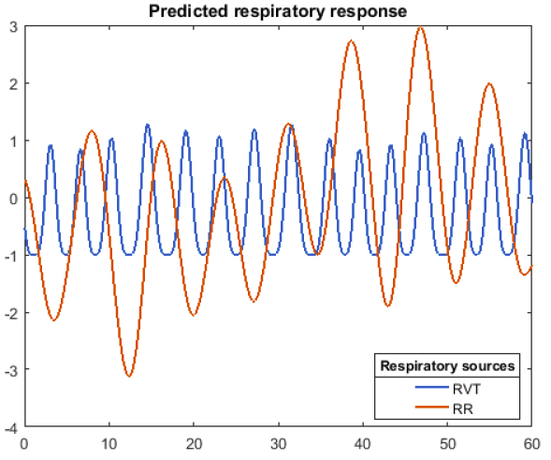
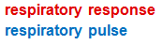
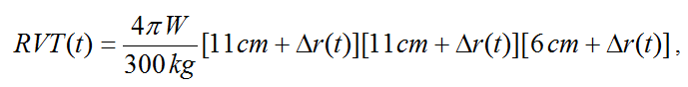
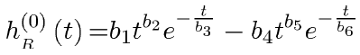
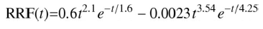
Presenting STANCE Implementation 4D: respiratory volume, RRF
The vertical displacement of the chest during regular respiration is then modeled for the i^{th} cycle as
Next the respiratory volume and response are estimated.

Slide 27



Presenting STANCE Implementation 4D: Cardiac noise
The vertical displacement of the chest during regular respiration is then modeled for the i^{th} cycle as
The modeling of cardiac noise begins with modeling of the instantaneous heart beat rate from an Integral Pulse Frequency Modulation (IPFM) model.
Analysis of HRV data for healthy subjects in a supine position yields a set of three almost equally weighted spectral bands at (VLF) ω₁ = 0.01-0.03, (LF) ω₂ = 0.09-0.11 and (HF) ω₃ = 0.2-0.3 Hz.
The instantaneous heart rate = (1 + m(t))/T

Slide 28





Presenting STANCE Implementation 4D: Pulse wave velocity, CRF
The vertical displacement of the chest during regular respiration is then modeled for the i^{th} cycle as
Next the cardiac pulse and response are estimated.

Slide 29




Presenting STANCE Implementation 4D: variability in tissue types
The vertical displacement of the chest during regular respiration is then modeled for the i^{th} cycle as

Slide 30
Presenting STANCE Implementation 4D: add motion
The vertical displacement of the chest during regular respiration is then modeled for the i^{th} cycle as
After the addition of physiological noise, but before adding system noise, motion is added to the time-series.
6 motion parameters can be estimated from real data.
Apply rigid body motion translations and rotations according to the slice timing of the fMRI scan.
Estimate spin-history effects geometrically by the amount of the slice volume that moves off resonance.

Slide 31
Presenting STANCE Implementation 4D: add motion
The vertical displacement of the chest during regular respiration is then modeled for the i^{th} cycle as
After the addition of physiological noise, but before adding system noise, motion is added to the time-series.
6 motion parameters can be estimated from real data.
Apply rigid body motion translations and rotations according to the slice timing of the fMRI scan.
Estimate spin-history effects geometrically by the amount of the slice volume that moves off resonance.

Slide 32


Presenting STANCE Example Results: experimental boxcars
The vertical displacement of the chest during regular respiration is then modeled for the i^{th} cycle as
From Chris Rorden’s educational website use alternating L/R-handed finger tapping task experimental design boxcars:

Slide 33


Presenting STANCE Example Results: 3D activation maps
The vertical displacement of the chest during regular respiration is then modeled for the i^{th} cycle as
From NeuroSynth.org construct peak sustained neurological activation maps for finger tasks based on observed amplitudes:

Slide 34


Presenting STANCE Example Results: simulated EPI signal
The vertical displacement of the chest during regular respiration is then modeled for the i^{th} cycle as
Synthetic fMRI data can now be constructed (with spatial variability of HRF proof-of principle in demo):
Noise standard deviations fit to what is observed in real data which varies with tissue type.
(CSF dominated)
(GM dominated)

Slide 35


Presenting STANCE Example Results: simulated EPI signal + noise
The vertical displacement of the chest during regular respiration is then modeled for the i^{th} cycle as
Add physiological noise and then all noise with system also:

Slide 36

Presenting STANCE Example Results: load motion time-series
The vertical displacement of the chest during regular respiration is then modeled for the i^{th} cycle as
Load the estimated time-series of the 6 motion parameters:
Note: the y-displacement time-series is observed to be modulated by breathing.

Slide 37


Presenting STANCE Example Results: more fully simulated EPI
The vertical displacement of the chest during regular respiration is then modeled for the i^{th} cycle as
Add motion and then all noise + motion:
Note: motion is task dependent.

Slide 38


Presenting STANCE Example Results: compare with real data
The vertical displacement of the chest during regular respiration is then modeled for the i^{th} cycle as
Compare representative voxel time-series:

Slide 39


Presenting STANCE Example Results: compare with real data cont.
The vertical displacement of the chest during regular respiration is then modeled for the i^{th} cycle as
Representative voxel time-series averaged over blocks:

Slide 40
Presenting STANCE
THANK YOU.

